Slide 1


LOS ANGELES
CRIME ANALYSIS
DSO 545: FINAL PROJECT, MS in BUSINESS ANALYTICS, FALL 2021
PROF. ABBASS SHARIF

Slide 2


A) INTRODUCTION
Focus Statement
“ In this project, we investigate historical crime data obtained from the Los Angeles Police Department (LAPD) to explore the victims’ characteristics influencing their likelihood of being targeted for crimes. ”

Slide 3
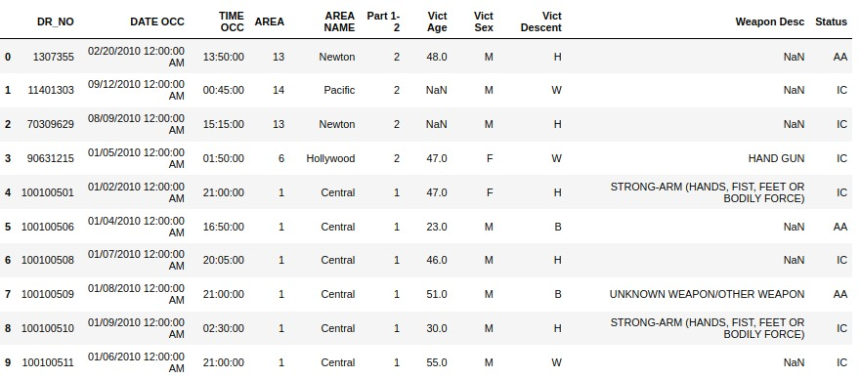
B) EXPLORATORY DATA ANALYSIS
1
The Data Set
The data set includes crime information for LA county from 2010 to 2021.
The raw data set consists of 2.1 million rows and 29 columns with granularity at the individual incident level.
The information that we chose to focus on can be found in the following columns:
DR_NO, DATE OCC, TIME OCC, AREA, AREA NAME, Part 1-2, Vict Age, Vict Sex, Vict Descent, Weapon Desc, Status
Notes:
DR_NO is the unique number associated with each case/incident

Slide 4
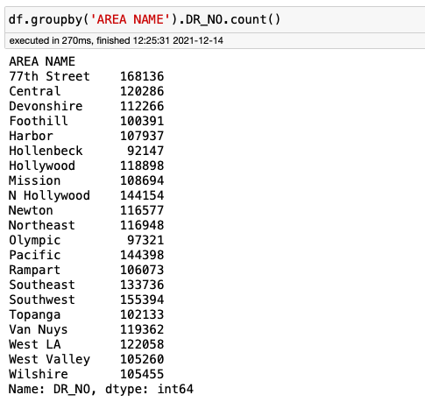
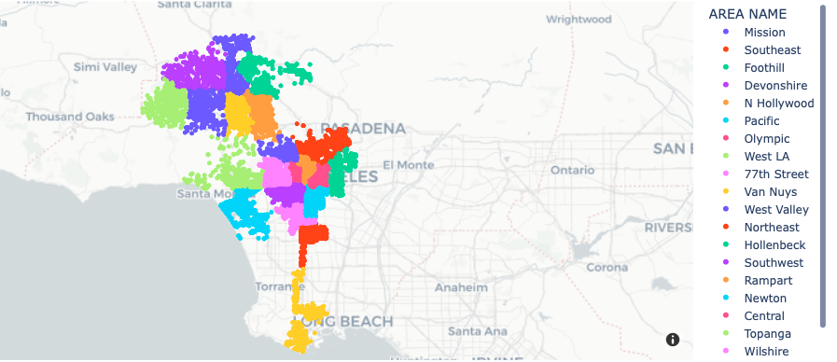
B) EXPLORATORY DATA ANALYSIS
2
Areas in LA County and their Crime Counts

Slide 5
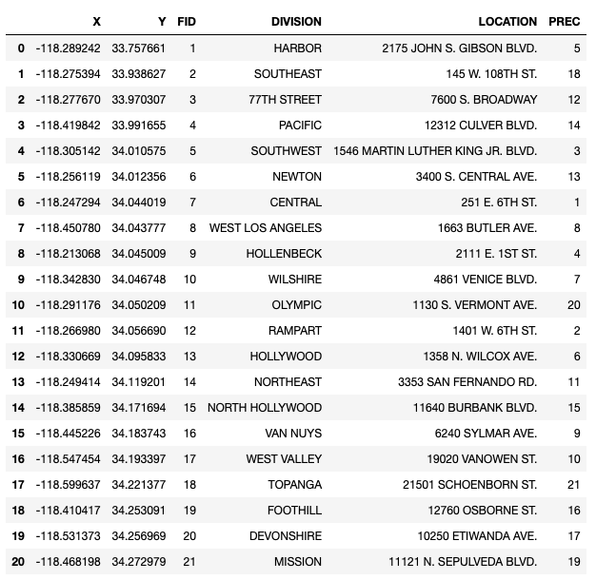
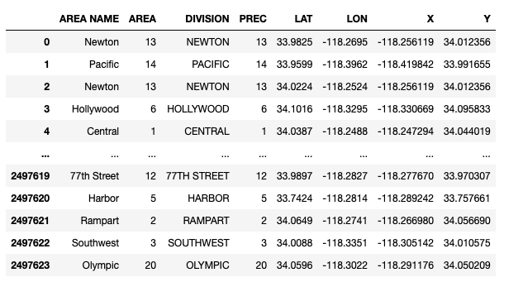
B) EXPLORATORY DATA ANALYSIS
3
Location of the Precincts
Table 1
Table 2
Table 1 describes data across 21 precincts in LA that correspond to the areas denoted by the area name variable.
Table 2 is merged data that includes the latitude and longitude coordinates for the crime incidents as well as precincts

Slide 6
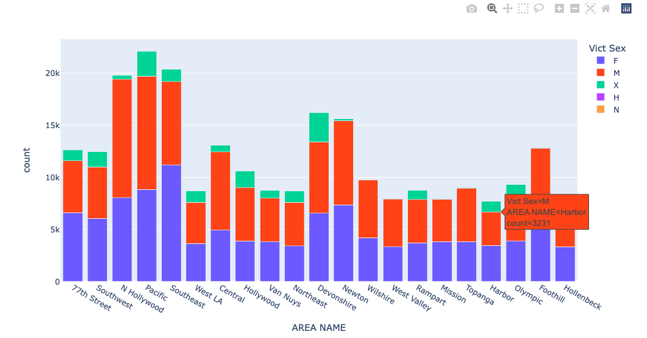
B) EXPLORATORY DATA ANALYSIS
4
Gender and Crime Counts by Area
Crime Counts Colored by Victim’s Gender across LA
The graph represents the relationship between crime counts and gender for 21 areas across LA county.
Victim sex is categorized as follows:
Female - F
Male - M
Unknown - X,H,N

Slide 7
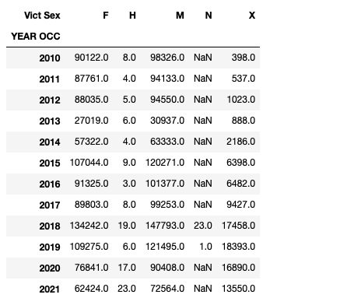
B) EXPLORATORY DATA ANALYSIS
5
Gender and Crime Counts by Year
The table describes the count of crimes by gender for each year.
Victim sex is categorized as follows:
Female - F
Male - M
Unknown - X,H,N

Slide 8
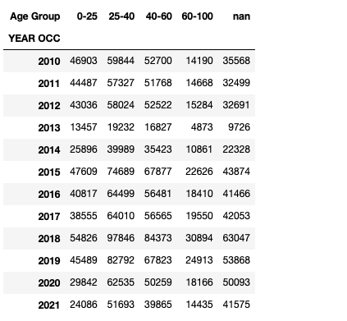
B) EXPLORATORY DATA ANALYSIS
6
Crime Counts by Year and Age Groups
The table describes the crime counts for various age groups of victims who were targeted for a period of 11 years.
Age is grouped (in years) as follows:
0 - 25
25 - 40
40 - 60
60 - 100
The missing information on targeted victims’ age groups is represented by ‘nan’ which accounts for 0.672% of the total crime counts.

Slide 9
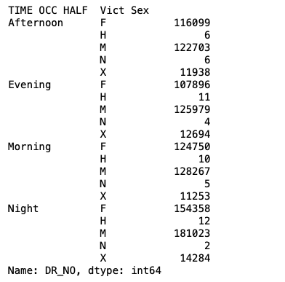
B) EXPLORATORY DATA ANALYSIS
7
Gender Crime Counts and Time of Occurrence
The table describes crime counts based on time of occurrence and the gender of victims.
The time of occurrence is categorized as follows:
Morning: 4 AM - 12 PM
Afternoon: 12 PM - 4 PM
Evening: 4 PM - 8 AM
Night: 8 PM - 4 AM
Notes:
M -4 AM - 12PM
A - 12 - 4
E - 4-8
N-8 - 4AM

Slide 10
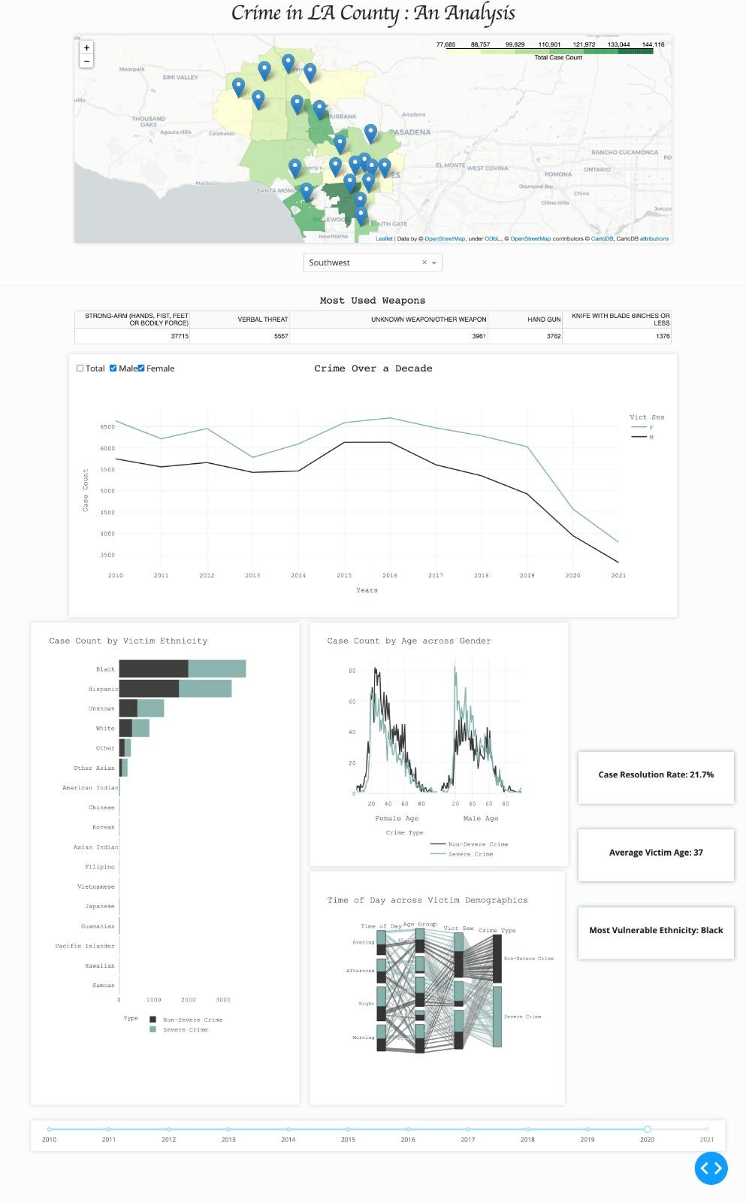
C) DASHBOARD
1
Dashboard at a Glance

Slide 11
C) DASHBOARD
2
Dashboard design, users and uses
The analysis is intended to provide civilians with crime statistics in a given area over the years.
The characteristics such as victim gender, victim age, victim descent, weapon used, area of crime
The dashboard provides the user with tables and charts describing:
The visualization metrics such as count of cases, resolution rate, average age, etc.
The dashboard would help a civilian understand the characteristics of the victims of crimes in Los Angeles between 2010 and 2021.
Notes:
characteristics/summary statistics
The analysis is intended to provide civilians with crime statistics in a given area over the years.
The dashboard would help a civilian understand the characteristics of the victims of crimes in Los Angeles between 2010 and 2020.
The dashboard provides the user with tables and charts describing the characteristics such as victim gender, victim age, victim descent, weapon used, area of crime and visualize metrics such as count of cases, YoY comparison, resolution rate, average age, etc.,

Slide 12
C) DASHBOARD
3
Flow of Information
- Where did most crimes occur? - Where are the precincts in LA? - Diving deep into crimes in these precincts
- To which age groups did these victims belong? - How many of these victims were a part of severe or non-severe crimes?
What were the ethnicities of these victims?
Heat Map
Faceted Line Chart
Bar Graph
Line Chart
Parallel Category Diagram
- Over a period of 10 years, how many crimes had male or female or both victims, for a given area?
- During what time of the day were these victims targeted?
-Were these victims part of severe or non-severe crimes?

Slide 13
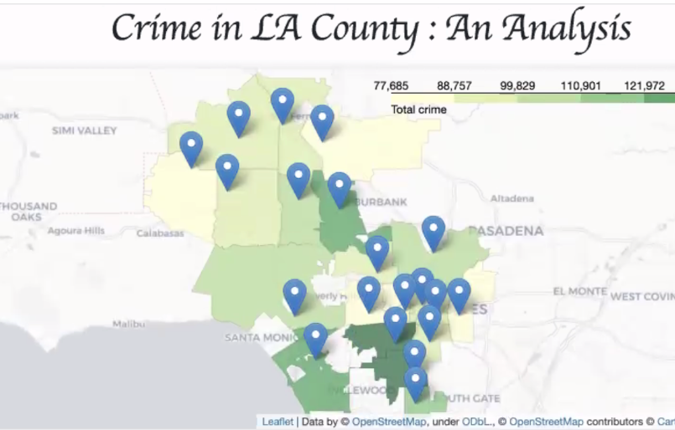
C) DASHBOARD
4
Heat map
The heat map represents the overview of crime in each of LA County’s 21 areas.
The color indicates the density of crimes in a particular area. The darker the color, the higher the crime counts.
The blue markers indicate the location of the LAPD precinct for each area.

Slide 14

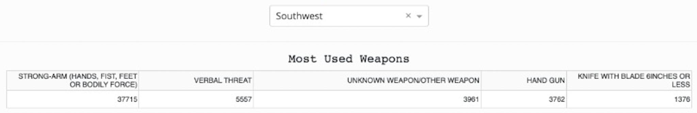
C) DASHBOARD
5
Interactive drop-down to select Area
The drop-down in this section allows the user to switch the focus of visualizations among different areas.
By default, the user can view the graphs for ‘Southwest’ precinct area of LA county.
The drop-down affects all the visualizations below it.
Notes:
The user simply needs to select a location through the drop down and the following graphs would dynamically change based on the selected area.

Slide 15
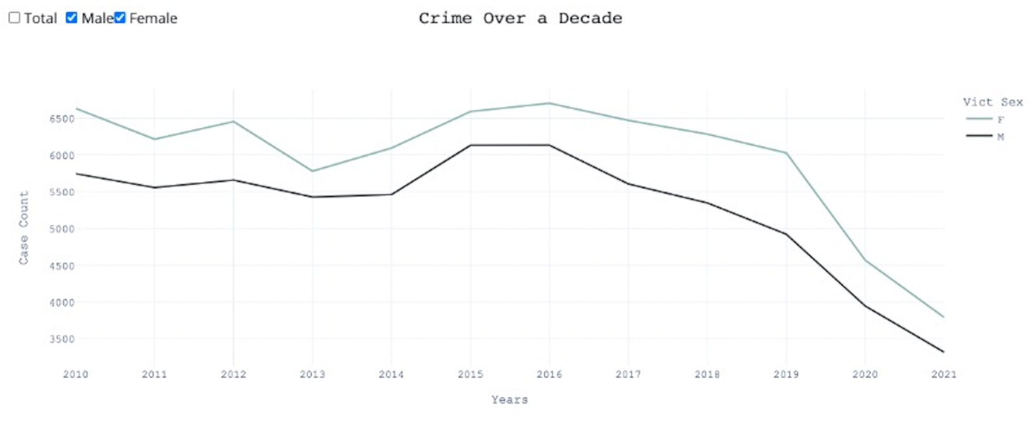
C) DASHBOARD
6
Crime Over a Decade
The line chart represents crime counts from 2010 to 2021.
The user can select ‘Male’ and/or ‘Female’ to visualize the respective crime counts.
Alternatively, the user can also choose ‘Total’ to visualize the total crime counts over 10 years.
Notes:
The user simply needs to select a location through the drop down and the following graphs would dynamically change based on the selected area.

Slide 16
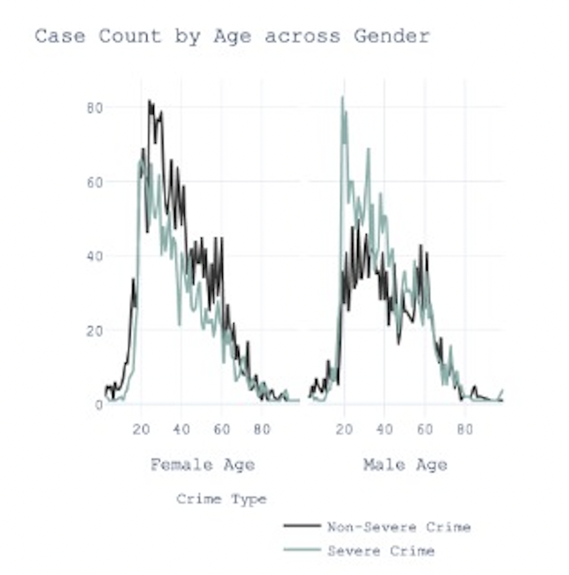
C) DASHBOARD
7
Gender, Age and Severity of the crime
The faceted line chart showcases the relationship between age of victim and crime count for males and females.
This chart represents the crime counts for a particular year (default = 2020) selected by the user via the slider at the end of the dashboard.
The colors represent the severity of crime (Part 1-2 in the data set):
Green represents severe (Part 1) crimes
Black represents non-severe (Part 2) crimes
The faceted line chart changes according to the year selected on the year slider.

Slide 17
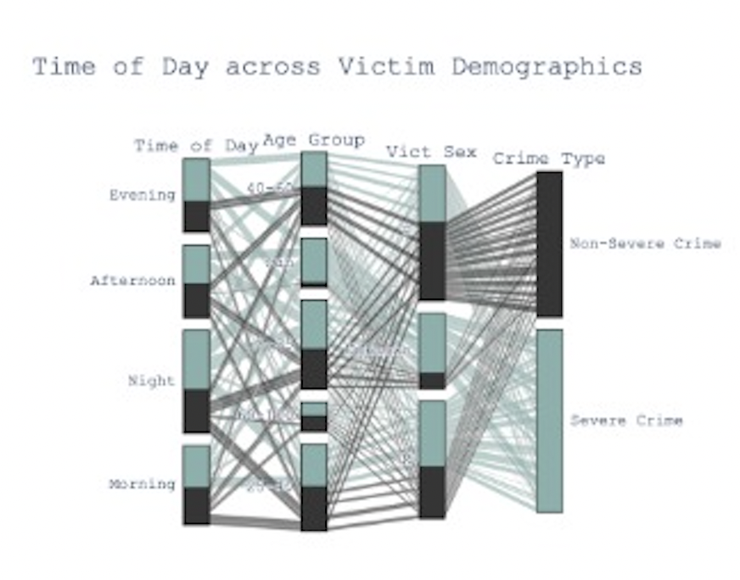
C) DASHBOARD
8
Gender, Age, Time of the day & Severity
This parallel category diagram showcases the relationship among
time of day of crime
victim age
victim gender, and
crime severity
The diagram represents crime data for a year (default = 2020) selected by the user via the slider at the end of the dashboard.
The colors represent the severity of the crime (Part 1-2 in the data set):
Green represents severe (Part 1) crimes
Black represents non-severe (Part 2) crimes
The parallel category diagram can be viewed for each year selected on the year slider.

Slide 18
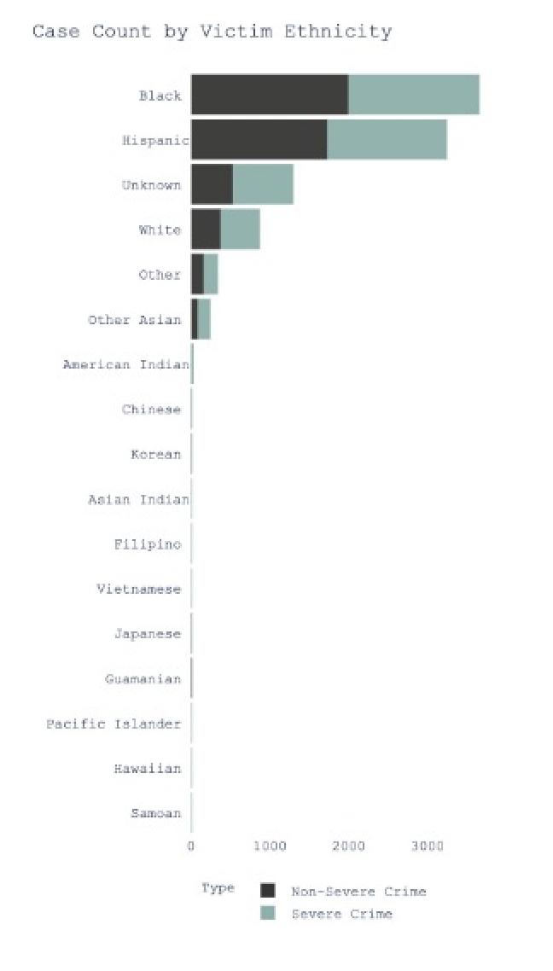
C) DASHBOARD
9
Number of Crimes, Victim Ethnicity and Severity of the Crime
This horizontal bar chart illustrates the relationship between ethnicity of victim and absolute case count.
The diagram represents crime data for a year (default = 2020) selected by the user via the slider at the end of the dashboard.
The colors represent the severity of the crime (Part 1-2 in the data set):
Green represents severe (Part 1) crimes
Black represents non-severe (Part 2) crimes
The horizontal bar chart can be viewed for each year selected on the year slider.

Slide 19
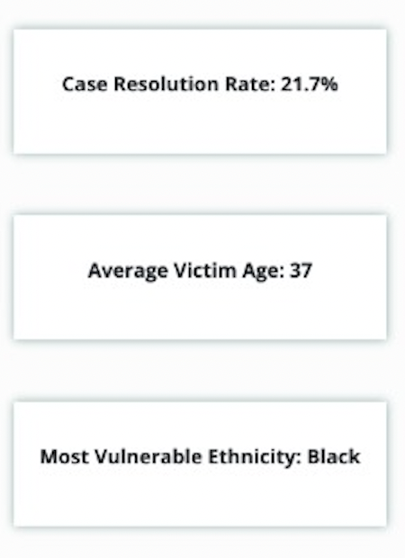
C) DASHBOARD
10
Key Metrics
Case Resolution Rate represents the percentage of cases that were resolved for a user selected area and year
Average Victim Age represents the average age of victim for a user selected area and year
Most Vulnerable Ethnicity represent the ethnicity with the highest case counts in the data for a user selected area and year

Slide 20
D) CHALLENGES
EDA
Data Cleaning Process
Values in the ‘Gender’ and ‘Age’ columns were missing
‘Gender’ missing value : 0.472%
‘Age’ missing values : 0.672%
Data for the year 2013 was missing
Precinct Longitude and Latitude missing values (reconciled)
Data Generating Process
Only reported cases were present, unreported cases with LAPD are missing
Notes:
characteristics/summary statistics

Slide 21
E) APPENDIX
Sources and References
Article:
https://www.latimes.com/local/la-me-crimestats-lapd-20140810-story.html
Dataset:
https://data.lacity.org/Public-Safety/Crime-Data-from-2010-to-2019/63jg-8b9z
Dataset:
Crime Data from 2020 to Present | Los Angeles - Open Data Portal
Plotly:
https://plotly.com/python/
Notes:
characteristics/summary statistics

